Slide 1
Course Title: Engineering Chemistry-1
Course Code: CHE109
(Chapter 9)
Dr. Joyanta Kumar Saha
Associate Professor
Department of Chemistry
Jagannath University

Slide 2
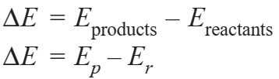
Thermochemistry
Thermochemistry is the branch of physical chemistry which deals with the thermal or heat changes caused by chemical reactions. When the internal energy of reactants (Er) is greater than the internal energy of the products (Ep), the difference of internal energy, ΔE, is released as heat energy.
Such a reaction is called exothermic reaction. If the internal energy of the products (Ep) is greater than that of the reactants (Er), heat is absorbed from the surroundings. Such a reaction is called endothermic reaction. The amount of heat released or absorbed in a chemical reaction is termed the heat of reaction.

Slide 3
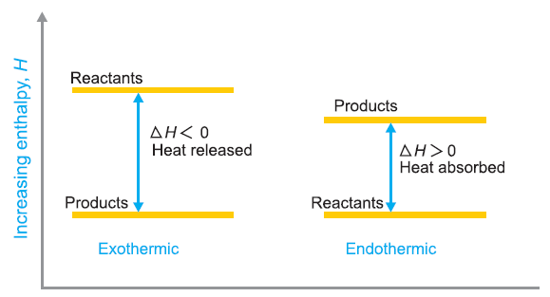
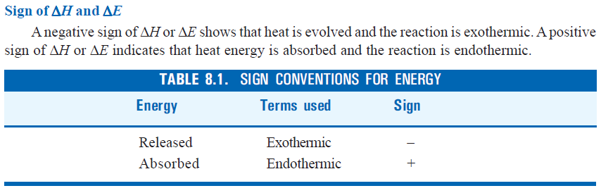
The enthalpy of a system is defined as the sum of the internal energy and the product of its pressure and volume. That is,
H = E + PV
where E is the internal energy, P is the pressure and V is the volume of the system. It is also called Heat content.

Slide 4
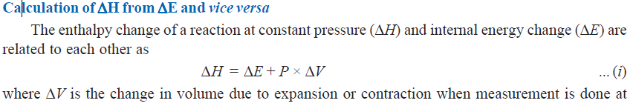
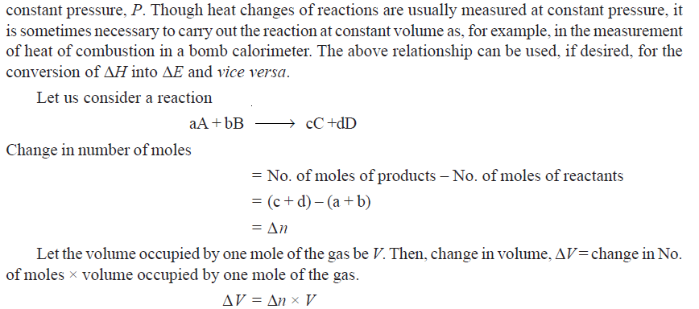

Slide 5
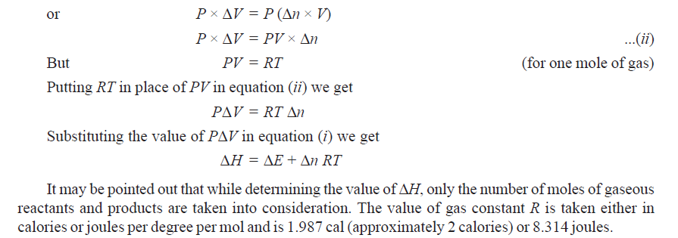

Slide 6
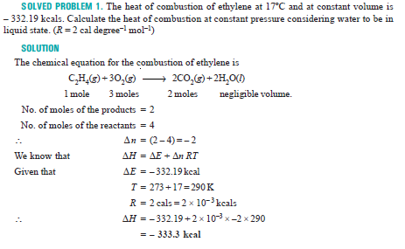

Slide 7
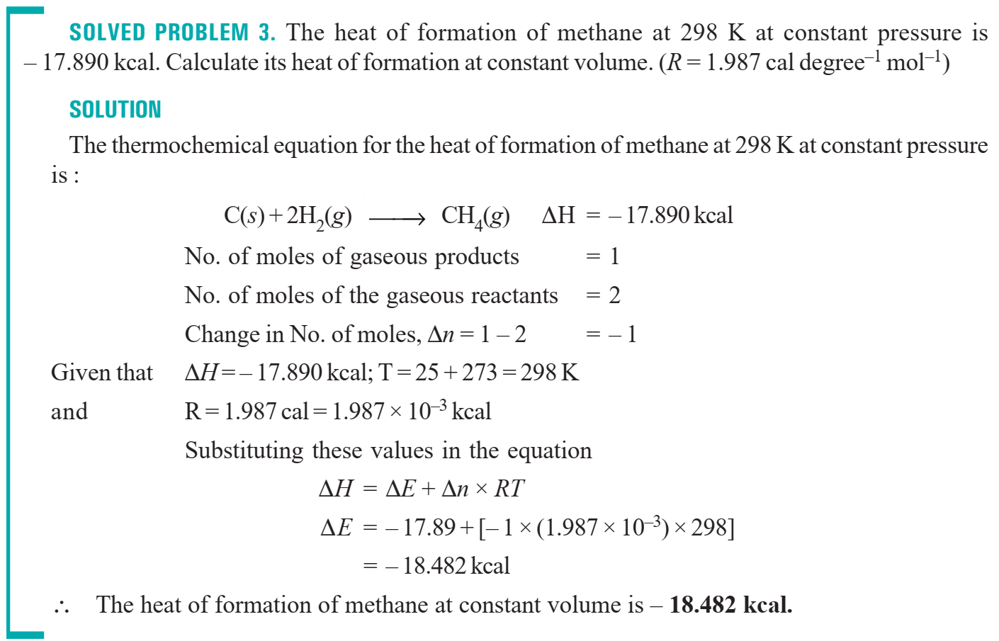

Slide 8
HEAT OF FORMATION: The change in enthalpy that takes place when one mole of the compound is formed from its elements.
HEAT OF COMBUSTION: the change in enthalpy of a system when one mole of the substance is completely burnt in excess of air or oxygen.
HEAT OF SOLUTION: the change in enthalpy when one mole of a substance is dissolved in a specified quantity of solvent at a given temperature.
HEAT OF NEUTRALISATION: the change in heat content (enthalpy) of the system when one gram equivalent of an acid is neutralized by one gram equivalent of a base or vice versa in dilute solution.
BOND ENERGY: The bond energy is defined as the average amount of energy required to break all bonds of a particular type in one mole of the substance.

